Slide 1

Computer Architecture
A Quantitative Approach
Chapter 3 and Appendix C
Dynamic Branch Prediction

Slide 2

Review Question
Assume a machine has a 6-stage pipeline
  The branch direction and target are known in the 5th stage
  20% of instructions are branches on average
  Branch is statically predicted as not-taken
  60% correct prediction on average
How many cycles are wasted per branch misprediction on this machine?
A. 3
B. 4
C. 5
D. 6
Notes:
>>
The number of cycles wasted per branch misprediction is
determined by the number of pipeline stages between
the point where the branch outcome is known
and the point where the prediction is made.
In this case,
the branch direction and target are known in the 5th stage of the 6-stage pipeline,
meaning the prediction is resolved in stage 5.
Since branch prediction occurs during the fetch stage (stage 1),
the misprediction penalty is the number of stages from the fetch stage
to the stage where the branch is resolved, which is 5 - 1 = 4 stages.
So, B. is the answer.
Misprediction Cost
Pipeline: 6-stage pipeline.
Branch Resolution:
Branch direction and target are known in the 5th stage.
Branch Misprediction Cost:
The number of wasted cycles per misprediction is the number of stages after the prediction is made and before the branch outcome is known. In this case, stages 1-4 are wasted because the outcome is known in stage 5 of the 6-stage pipeline.
Calculation:
Cycles wasted = Stage where branch is known (5) - 1 (The stage the mispredicted instruction is in).
Assuming the branch is made in the first stage (IF), the mispredicted instruction will be in the IF stage. Wasted Cycles = $5 - 1 = 4$ cycles.
Options:
The provided options are 3, 4, 5, and 6 cycles. The answer is 4.

Slide 3
Review Question
Assume a machine has a 6-stage pipeline
  The branch direction and target are known in the 5th stage
  20% of instructions are branches on average
  Branch is statically predicted as not-taken
  60% correct prediction on average
What is the average CPI after the control stalls are considered? Assume that there is no other stalls, and the ideal CPI is 1.
Notes:
>>
Average CPI = Ideal CPI + Branch Frequency * (1 – Prediction Accuracy) * Penalty
Average CPI = 1 + 0.2 * 0.4 x 4 = 1 + 0.32 = 1.32
Average CPI
Ideal CPI: Assumed to be 1 (no other stalls).
Branches: 20% of instructions are branches on average.
Prediction Accuracy: 60% correct prediction on average.
Misprediction Rate: 100% - 60% = 40%.
Misprediction Penalty (from Slide 1): 4 cycles.
Formula for Average CPI:
Ideal CPI + Branch Frequency * Misprediction Rate * Misprediction Penalty.
Calculation:
Average CPI = 1 + (0.20 * 0.40 * 4) = 1 + (0.08 * 4) = 1 + 0.32 = 1.32

Slide 4
Outline
ILP
Compiler techniques to increase ILP
Loop Unrolling
Static Branch Prediction (done before)
Dynamic Branch Prediction
Overcoming Data Hazards with Dynamic Scheduling
(Start) Tomasulo Algorithm
Conclusion

Slide 5
Dynamic Branch Prediction
Why does prediction work?
  Underlying algorithm has regularities
  Data that is being operated on has regularities
  Instruction sequences often contain redundancies that stem from the way humans or compilers conceptualize and solve problems.
Is dynamic branch prediction better than static branch prediction?
  Higher accuracy and adaptability
  There are a small number of important branches in programs that have dynamic behavior
Notes:
>>
Q. Why does prediction work?
(arrow down)
A. Branch prediction works by leveraging regularities in program behavior to reduce pipeline stalls caused by conditional branches.
(Also, cover the bullet points in the slide.)
Definition:
Dynamic branch prediction is a technique used
to improve performance by making educated guesses about
the outcome of branch instructions before they are resolved.
(arrow down)
Q. Is dynamic branch prediction better than static branch prediction?
(arrow down)
A. Dynamic branch prediction is generally considered superior to static branch prediction
prediction due to its higher accuracy and adaptability to runtime behavior.
(Also, cover the bullet points in the slide.)

Slide 6
Dynamic Branch Prediction
Performance = ƒ(accuracy, cost of misprediction)
Branch History Table (BHT)
  Lower bits of PC address index table of 1-bit values
  Says whether or not branch taken last time
  No address check
Problem: in a loop, 1-bit BHT will cause two mispredictions (average is 9 loop iterations before exit):
  End of loop case, when it exits instead of looping as before
  First time through loop on next time through code,
  when it predicts exit instead of looping
Notes:
>>
The performance of a branch predictor is fundamentally determined by
its accuracy and the cost associated with a misprediction.
Performance = ƒ(accuracy, cost of misprediction)
This means that the effectiveness of the predictor is not solely dependent on how often it predicts correctly,
but also on the penalty incurred when it makes an incorrect prediction.
(arrow down)
Branch History Table
Dynamic branch prediction uses the past behavior of branches to predict their future outcomes,
relying on hardware to make these predictions based on runtime behavior.
The Branch History Table (BHT),
functions as a crucial small memory structure in this process and
is indexed by the lower bits of the program counter address of a branch instruction.
Each entry in the BHT contains a single bit that indicates
whether the branch was taken or not taken
during its most recent execution.
This prediction is essentially a hint used to determine the next instruction to fetch,
and the BHT operates without performing an address check.
(arrow down)
Problem
When a loop is executed,
the 1-bit BHT records only the most recent branch outcome,
which will lead to two mispredictions in a loop.
One when the loop exits instead of looping.
At the end of the first iteration of the loop,
when it predicts exit instead of looping.
Optional elaboration:
The first misprediction occurs at the end of the loop, when the branch is not taken to exit the loop,
but the predictor, having remembered the previous iteration's taken state, incorrectly predicts it will be taken again.
The second misprediction happens when the loop is entered again,
as the predictor still holds the "taken" state from the previous exit,
causing it to predict a taken branch when the loop is first entered,
even though the branch should be taken only after the initial iteration.

Slide 7
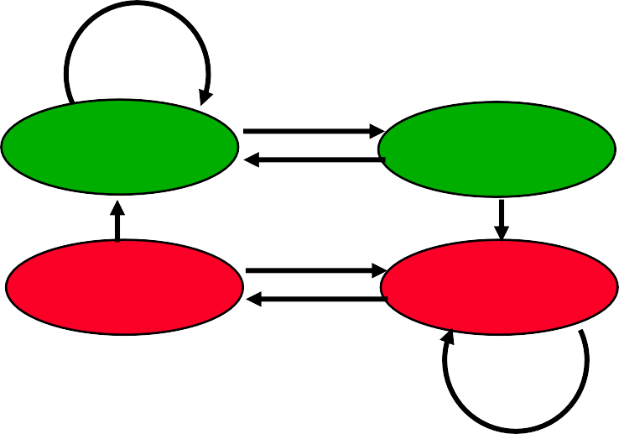
Dynamic Branch Prediction
Solution: 2-bit scheme where change prediction only if get misprediction twice
T
NT
Predict Taken
Predict Taken
T NT
T
NT
Predict Not
Taken
Predict Not
Taken
T
NT
H&P Figure C.18
Red: stop, not taken
Green: go, taken
Adds hysteresis to decision making process
Notes:
>>
The 2-bit branch predictor addresses the limitations of the 1-bit predictor
by using a hysteresis counter with four distinct states
to reduce mispredictions caused by short-term fluctuations in branch behavior.
This scheme changes its prediction only after two consecutive mispredictions,
introducing hysteresis to stabilize predictions and improve accuracy.
hysteresis:
a property that prevents a branch predictor's state from changing immediately after a single misprediction
T: Taken
N: Not Taken

Slide 8
BHT Accuracy
Mispredict because either:
  Wrong guess for that branch
  Got branch history of wrong branch when index the table
4096 entry table:
20%
18%
16%
14%
12%
10%
8%
6%
4%
2%
0%
18%
H&P Figure C.19
Misprediction Rate
12%
10%
9%
9% 9%
5%
5%
0%
1%
gcc
li
SPEC89
eqntott
spice
doduc
spice
fpppp
nasa7
espresso
matrix300
Integer
Floating Point
Notes:
>>
Mispredictions occur due to two primary reasons:
either the prediction is incorrect for the specific branch,
or the table index causes aliasing,
where the history of a different branch with the same lower address bits is used.
(H&P Figure C.19)
The figure shows misprediction rates for SPEC89 benchmarks using a 4096-entry table with a 2-bit prediction buffer.
(Prediction accuracy of a 4096-entry 2-bit prediction buffer for the SPEC89 benchmarks.)
The misprediction rate for the integer benchmarks is substantially higher (average of 11%)
than that for the floating-point programs (average of 4%).

Slide 9
Accuracy of Different Schemes
20%
4096 Entries 2-bit BHT
Mispredictions
18%
Unlimited Entries 2-bit BHT
16%
14%
12%
10%
8%
6%
4%
Frequency of
2%
0%
SPEC89
0%
nasa7
matrix300
tomcatv
doducd
spice
fpppp
gcc
expresso
eqntott
li
4,096 entries: 2-bits per entry Unlimited entries: 2-bits/entry 1,024 entries (2,2)
H&P Figure 3.3
Notes:
>>
This figure shows a comparison of 2-bit predictors.
A (noncorrelating) predictor for 4096 bits (in red),
A (noncorrelating) 2-bit predictor with unlimited entries (in green)

Slide 10
Correlated Branch Prediction
Idea: record m most recently executed branches as taken or not taken, and use that pattern to select the proper n- bit BHT
In general, (m,n) predictor means record last m branches to select between 2^{m} history tables, each with n-bit counters
  Thus, old 2-bit BHT is a (0,2) predictor
  Global Branch History: m-bit shift register
  keeping T/NT status of last m branches.
– Each entry in table has 2^{m} n-bit predictors.
if (aa == 2)
aa = 0; if (bb == 2)
bb = 0; if (aa != bb) {
Notes:
>>
Idea:
Record the status (T/NT) of the m most recently executed branches
as taken or not taken (global branch history)
and use that pattern to select the appropriate n-bit BHT.
$(m, n)$ Predictor:
Uses the last m branches to select between 2^m history tables, each with n-bit counters.
Example:
A standard 2-bit BHT is considered a (0, 2) predictor.

Slide 11
Correlating Branches
– Behavior of recent branches is used to pick one prediction out of four predictions for the next branch, updating just that predictor
Another view of this design: 4 addr bits + 2 history bits give us 6-bit index into 2⁶ = 64 predictors, each having two bits ➔ 128 total bits.
(2,2) global correlation predictor
4
Branch address
Prediction
2-bits per branch predictor
1 0
Global branch history
Notes:
>>
Correlating (or two-level) dynamic branch predictors use the history of other recent branches to predict the current one,
while non-correlating predictors only use the history of the current branch
Mechanism:
The behavior of recent branches is used to pick one prediction out of four for the next branch, updating only that selected predictor.
Example:
(2, 2) Global Correlation Predictor:
Uses 4 address bits and 2 history bits (total 6 bits)
to index into 2^6 = 64 predictors, each having two bits, for a total of 128 bits.

Slide 12
A few Calculations
4096-entry 2-bit BHT
  4k x 2 = 8k bits
  4k = 2¹² ➔ 12 address bits
How to use the same # bits w/ a (2,2) predictor?
  8k bits w/ 2-bit BHT means 4k BHTs
  the (2, 2) implies an entry has four BHTs
  ➔ 1k entries, i.e. a (2,2) predictor w/ 1024 entries
Notes:
>>
For reference: (2-bit: (0, 2) predictor)
4096-entry 2-bit BHT size:
4096 * 2 = 8K bits.
4096 = 2^12, so this requires 12 address bits for indexing.
(arrow down)
Q. How to use the same number of bits with a (2,2) predictor?
(arrow down)
A.
Equivalently sized (2, 2) Predictor:
The (2, 2) implies an entry has 2^2 = 4 BHTs.
To maintain 8K bits:
8K bits / 2 bits per counter / 4 counters per entry = 1K entries.
So, a (2, 2) predictor with 1024 entries has a similar size

Slide 13
Accuracy of Different Schemes
20%
4096 Entries 2-bit BHT
Mispredictions
18%
Unlimited Entries 2-bit BHT 1024 Entries (2,2) BHT
16%
14%
12%
11%
10%
8%
Frequency of
6%
6%
6%
6%
5%
5%
4%
4%
2%
0%
SPEC89
1%
1%
0%
nasa7
matrix300
tomcatv
doducd
spice
fpppp
gcc
expresso
eqntott
li
4,096 entries: 2-bits per entry Unlimited entries: 2-bits/entry 1,024 entries (2,2)
H&P Figure 3.3
Notes:
>>
(Complete chart from slide 9.)
This figure shows a comparison of 2-bit predictors.
A noncorrelating predictor for 4096 bits (in red),
A noncorrelating 2-bit predictor with unlimited entries (in green)
A 2-bit predictor with 2 bits of global history and a total of 1024 entries.

Slide 14
Review Question
Consider a 2-bit hysteresis counter. Choose an invalid counter sequence. (assume the left most value is the initial value)
  00 01 11 10 00
  01 11 11 00 01
  11 10 00 00 01
  10 00 01 11 10
Notes:
>>
Answer: B 01 11 11 00 01
Cannot transition from 11 to 00.

Slide 15
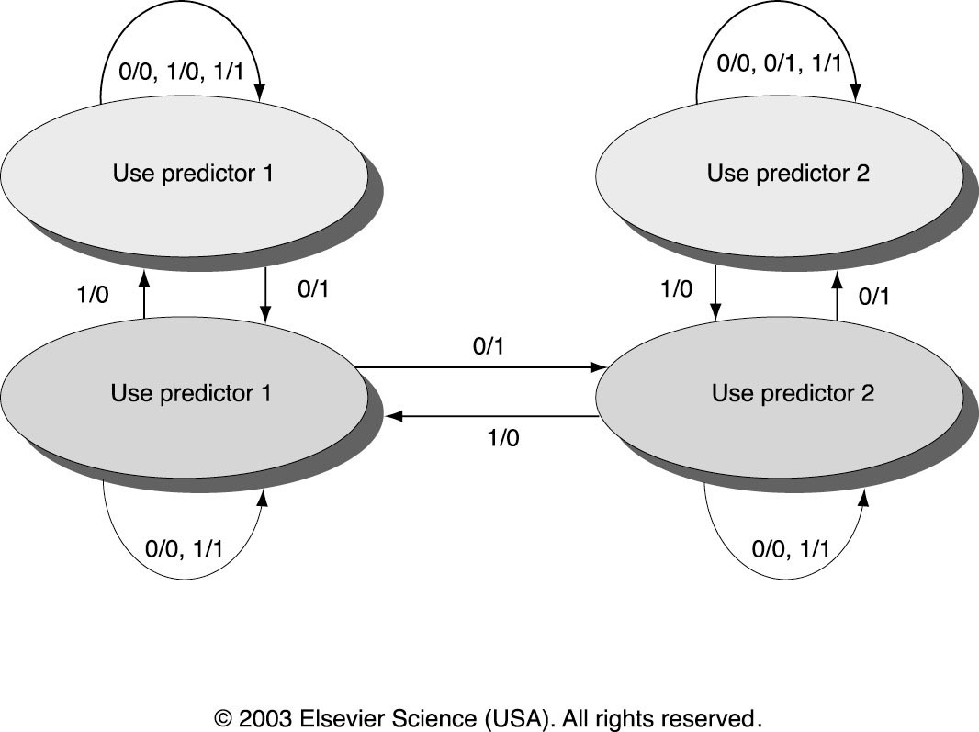

Tournament Predictors
Multilevel branch predictor
Use n-bit saturating counter to choose between predictors
Usually, choice between global and local predictors
Predictor 1 correct.
Predictor 2 incorrect.
Notes:
>>
Tournament predictors are a type of multilevel branch predictor that use multiple predictors
(typically, one based on global history, and one based on local history)
which will be combined using a selector mechanism (saturating counter)
to choose the most accurate predictor for each branch.
Concept: A multilevel branch predictor.
Uses an n-bit saturating counter (selector) to choose between different predictors.
Typically chooses between a global and a local predictor.
The selector counter is updated based on whether Predictor 1 or Predictor 2 was correct.

Slide 16
Tournament Predictors (Example)
Tournament predictor using, say,
Selector
  4K 2-bit counters indexed by local branch address.
Global predictor
  4K entries indexed by history of last 12 branches (2¹² = 4K)
  Each entry is a standard 2-bit predictor
  Irrelevant to specific branch address
Local predictor
  Local history table: 1K 10-bit entries recording last 10 branches, indexed by branch address
  The 10-bit pattern of that particular branch is used to index table of 1K entries with 3-bit saturating counters
Predictor Size
– 4K*2 + 4K*2 + 1K*10 + 1K*3 = 29K
Notes:
>>
For example:
Selector:
4K 2-bit counters (8K bits)
indexed by local branch address.
Global Predictor:
4K entries of 2-bit predictors (8K bits)
indexed by the history of the last 12 branches.
Local Predictor:
1K 10-bit local history table (10K bits)
and 1K entries with 3-bit counters (3K bits).
Predictor Size: Total 29K bits

Slide 17
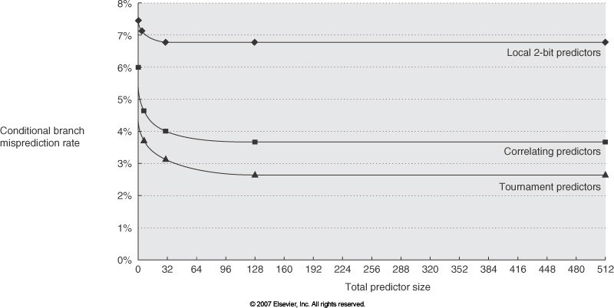
Comparing Predictors (H&P Fig. 3.4 , 5th ed.)
Advantage of tournament predictor is ability to select the right predictor for a particular branch
  Particularly crucial for integer benchmarks.
  A typical tournament predictor will select the global predictor almost 40% of the time for the SPEC integer benchmarks and less than 15% of the time for the SPEC FP benchmarks
6.8% 2-bit
3.7% Corr.
2.6% Tourn.
Notes:
>>
Advantage:
The advantage of tournament predictor is the
ability to select the right predictor for a particular branch.
This is especially crucial for integer benchmarks.
A typical tournament predictor selects
the global predictor ~40% of the time (for SPEC integer benchmarks).
The graph shows that
Tournament Predictors have the lowest misprediction rate (~2.6%)
compared to Correlating (~3.7%)
and Local 2-bit predictors (~6.8%) for a similar size.

Slide 18
Pentium 4 Misprediction Rate
(per 1000 instructions, not per branch)
≈6% misprediction rate per branch SPECint (19% of INT instructions are branch)
14
13
13
12
≈2% misprediction rate per branch SPECfp (5% of FP instructions are branch)
Branch mispredictions per 1000 Instructions
12
11
11
10
9
9
8
7
7
6
5
5
4
3
2
1
1
0
0
0
0
164.gzip
175.vpr
176.gcc
181.mcf
186.crafty
168.wupwise
171.swim
172.mgrid
173.applu
177.mesa

Slide 19
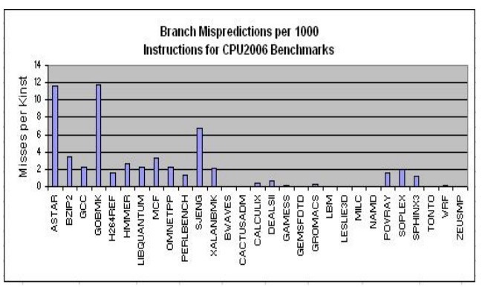
Branch Misprediction Per 1000 Instruction of SPEC CPU2006 Benchmarks; (Intel Core 2 Duo) / Source: Performance characterization of spec cpu2006 benchmarks on intel core 2 duo processor. ISAST Trans. Comput. Softw. Eng. 2, 1 (2008),

Slide 20
Examples of Branch Predictors
Pentium
  2-bit local predictor (Direct jump from (00) to (11) state)
Pentium MMX, Pentium Pro, Celeron, Pentium II
  (4, 2) correlating predictor
Pentium III
  2-level tournament predictor
  512-entry Branch Target Buffer (BTB) (later)
Pentium IV
  4096-entry BTB and execution trace cache
Intel Core i7
  Two-level predictor (smaller first-level, bigger second-level predictor)
  Each combines three predictors
» Simple 2-bit predictor,
» Global history predictor,
» A loop exit predictor

Slide 21
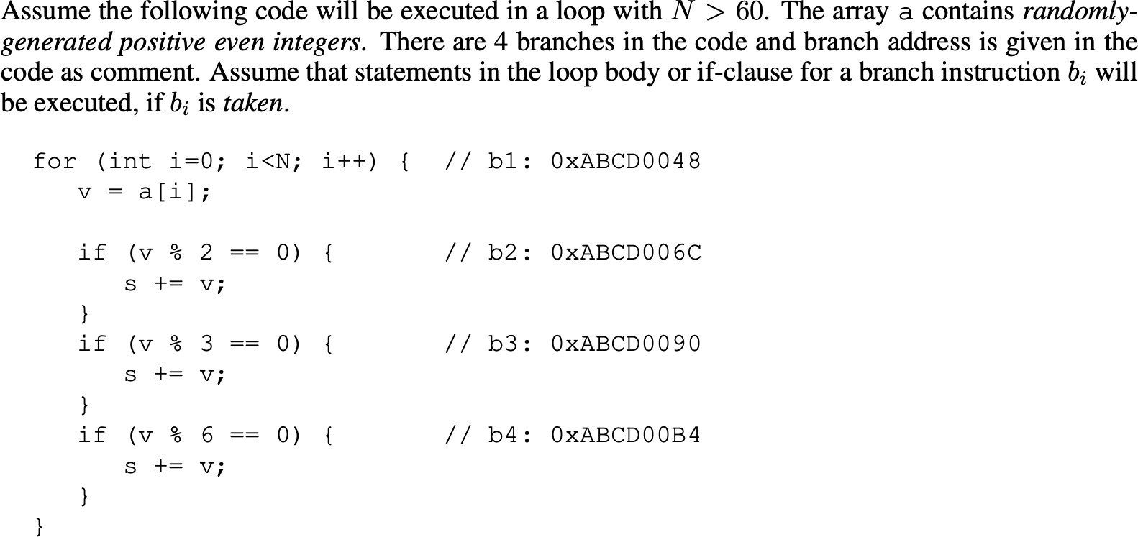
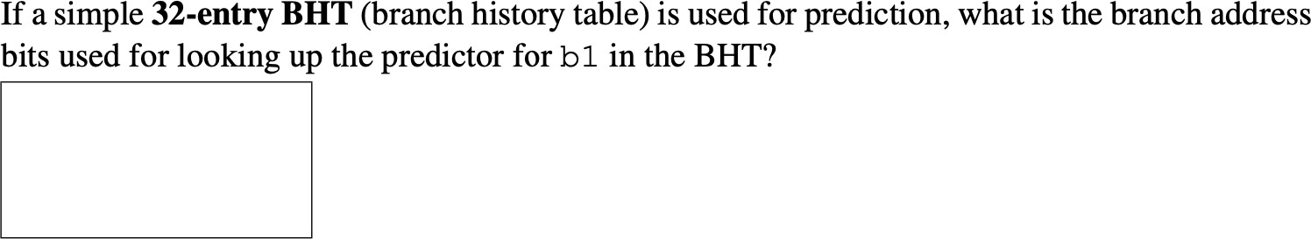
A sample problem
Notes:
>>
B1: 0xABCD0048
32-entry BHT (2^5 entries): 5-bit index
Answer: the lowest 5 bits

Slide 22
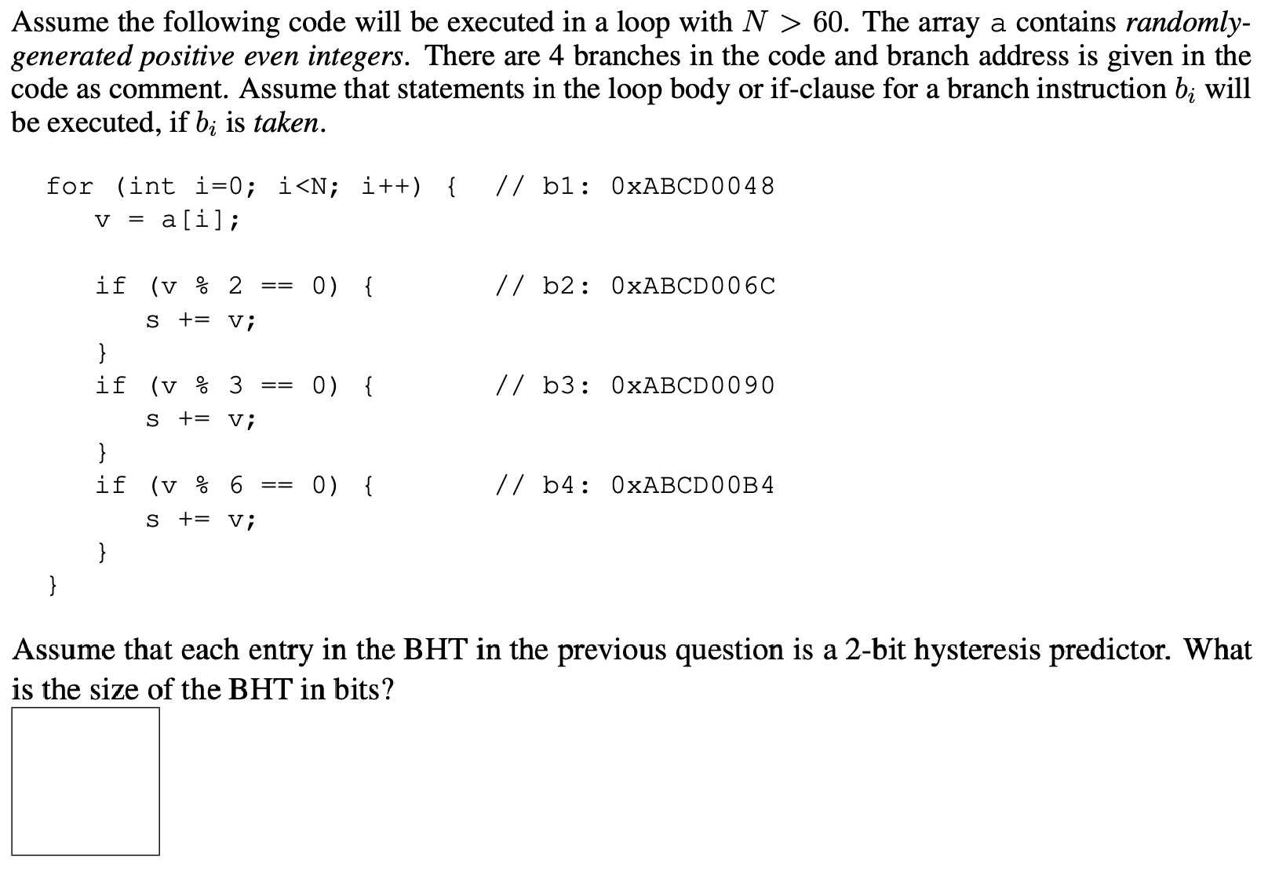
A sample problem
Notes:
>>
BHT: 32 * 2 = 64 bits (8 bytes)

Slide 23
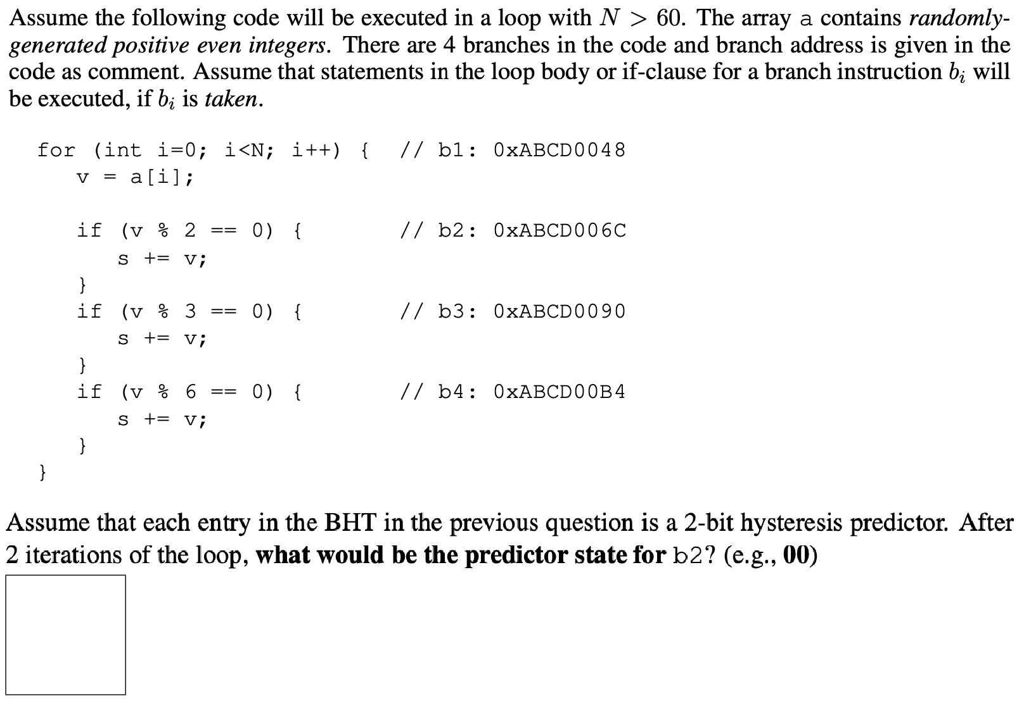
A sample problem
Notes:
>>
B2: 0xABCD006C
Initially: 00
B2 outcome: taken
Update: 01
B2 outcome: taken
Update: 11
Answer: 11

Slide 24
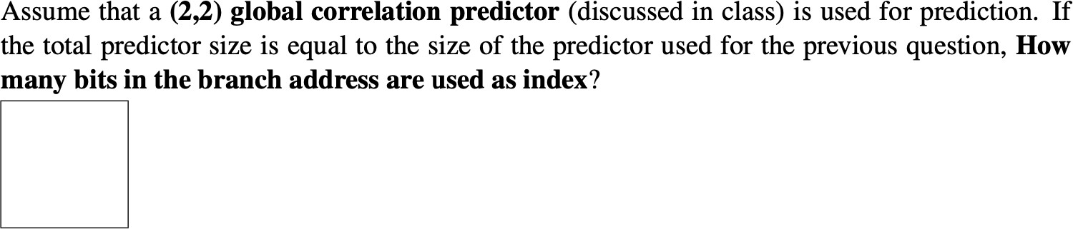
A sample problem
Notes:
>>
Predictor size: 64 bits
The (2, 2) implies an entry has 2^2 = 4 BHTs.
To maintain 64 bits:
64 bits / 2 bits per counter / 4 counters per entry = 8 entries.
8 (or 2^3) entries can be indexed by 3 bits.
Answer: 3 bits

Slide 25
Branch Target Buffers (BTB)
Branch target calculation is costly and stalls the instruction fetch one or more cycles.
BTB stores branch PCs and target PCs the same way that caches store addresses and data blocks.
The PC of a branch is sent to the BTB
In IF stage,
  When a match is found, the corresponding predicted target PC is returned
  If the branch is predicted to be Taken, instruction fetch continues at the returned predicted PC
Later, extra logic verifies predicted PC was correct and flushes all incorrectly fetched instructions from pipeline(s) without storing any results
Notes:
>>
A Branch Target Buffer (BTB) is
a specialized cache used to store the target addresses of recently executed branch instructions,
enabling the processor to predict and fetch the next instruction when a branch is encountered.
Purpose:
To overcome the cost of branch target calculation,
which can stall instruction fetch.
Function:
Stores the branch PCs and their target PCs,
(similar to how caches store addresses and data.)
Process (IF stage):
The PC of the instruction is sent to the branch target buffer (BTB).
If a match (BTB hit) is found,
the predicted target PC is returned.
If the branch is predicted Taken,
instruction fetch continues at the predicted PC.
If a misprediction occurs,
later logic verifies the prediction and
flushes incorrectly fetched instructions

Slide 26
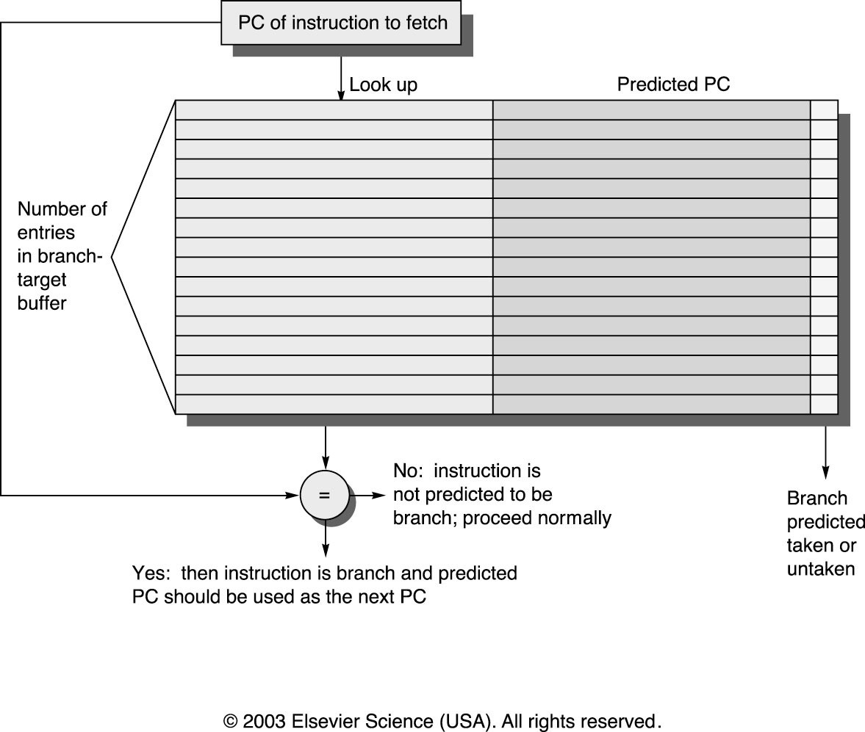
Branch Target Buffers (BTB)
26
Notes:
>>
This figure depicts a branch-target buffer.
The PC of the instruction being fetched is matched against
a set of instruction addresses stored in the first column;
these represent the addresses of known branches.
If the PC matches one of these entries,
then the instruction being fetched is a taken branch,
and the second field, predicted PC,
contains the prediction for the next PC after the branch.
Fetching begins immediately at that address.
The third field, which is optional,
may be used for extra prediction state bits.

Slide 27
Branch Target Buffers (BTB)
Accessed concurrently with the accessing of the I-cache
If PC matches an entry in BTB (a BTB hit), it implies
  The current instruction being fetched from the I-cache has been executed before and is a branch instruction.
  The BTA (branch target instruction) field of the hit entry is accessed and can be used as the next instruction fetch address,
  if the branch instruction is predicted to be taken
Notes:
>>
Branch Target Buffers (BTBs) are accessed concurrently
with the instruction cache (I-cache) during the instruction fetch stage of the pipeline,
using the program counter (PC) to index into the BTB.
If the PC matches an entry in the BTB, resulting in a BTB hit, it implies
that the current instruction being fetched
from the I-cache has been executed
before and is a branch instruction.
(cover the last bullet on the slide)

Slide 28
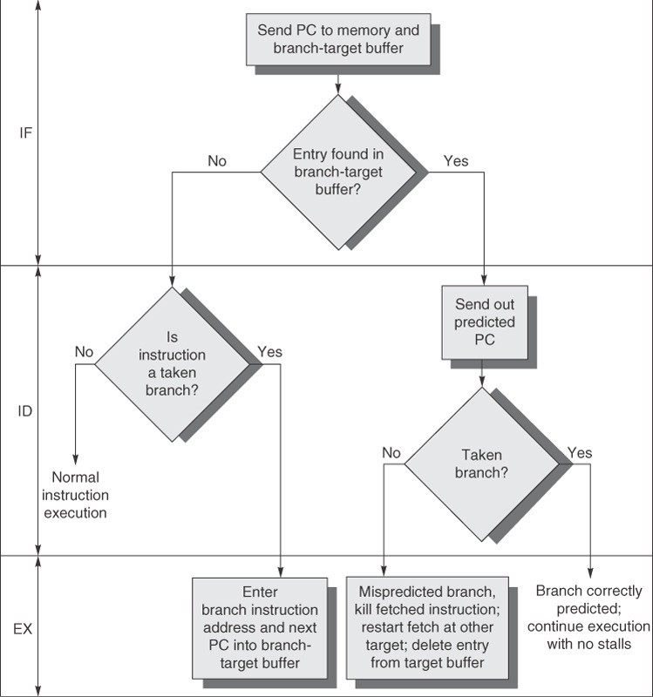
Notes:
>>
The steps involved in handling an instruction with a branch-target buffer.

Slide 29
Return Address Predictor (Ch. 3.9)
Function returns are frequent, yet
  Indirect jumps whose destination address varies at runtime
  (have to wait until EX stage done to know it)
  Difficult to predict with BTB
  (function can be called from multiple places)
  In SPEC CPU95, an aggressive branch predictor achieves an accuracy of less than 60% for such return branches
But return address is actually easy to predict
  It is the address after the last call instruction that we haven’t returned from yet
  Overcome the problem by using a small stack of return addresses
  Caches the most recent return address
  When a return instruction is executed,
  use the predicted return address
Notes:
>>
Problem:
Function returns are frequent but are indirect jumps
whose destination address (return address)
is hard to predict with a BTB because a function can be called from multiple places.
(arrow down)
Solution:
Use a small stack (Return Address Stack) to cache the most recent return address.
The return address is easy to predict:
it's the address after the last call instruction that hasn't returned yet.

Slide 30
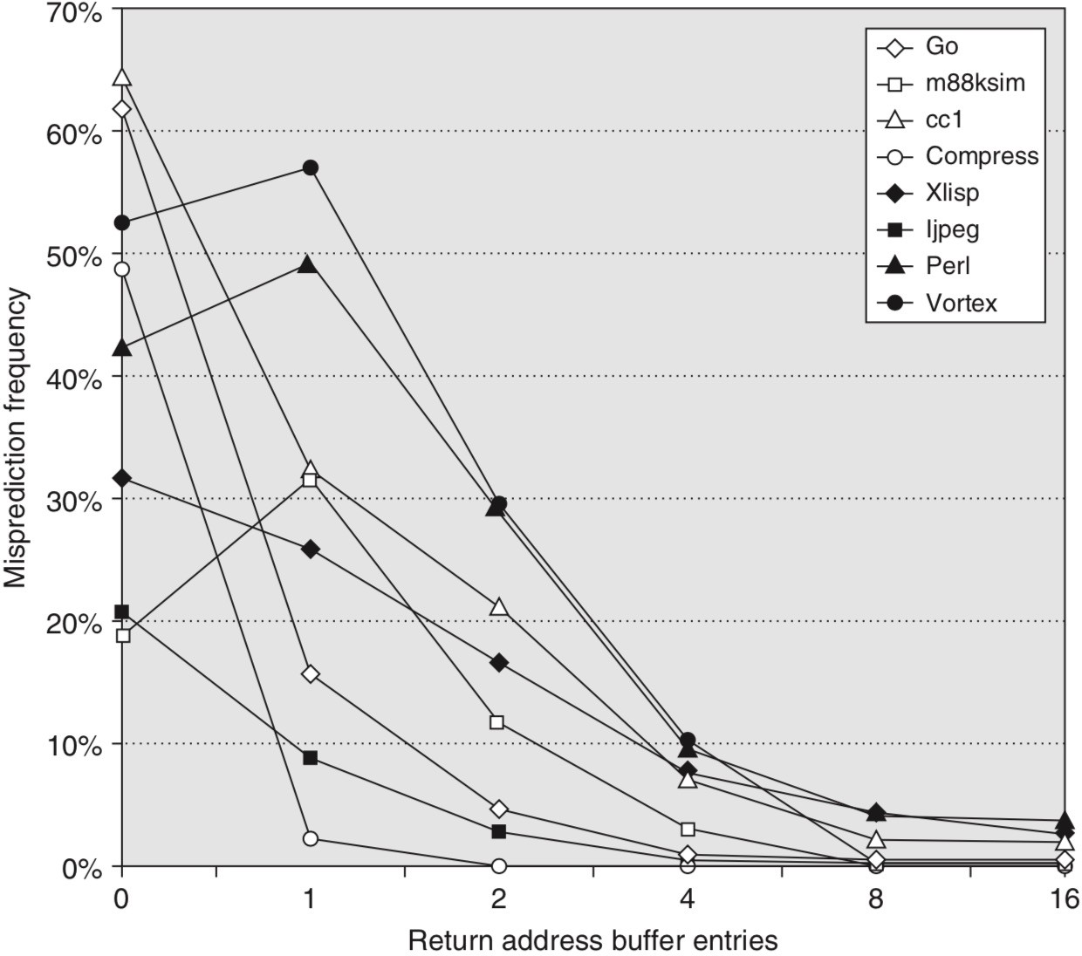
Return Address Predictor (Ch. 3.9)
– A buffer of 0 entries implies that the standard branch prediction is used.
Notes:
>>
This figure represents
prediction accuracy for a return address buffer
(operated as a stack on a number of SPEC CPU95 benchmarks).
The accuracy is the fraction of return addresses predicted correctly.
A buffer of 0 entries implies that the standard branch prediction is used.
Optional:
Because call depths are typically not large, with some exceptions, a modest buffer works well.

Slide 31
Dynamic Branch Prediction Summary
Prediction becoming important part of execution
Branch History Table: 2 bits for loop accuracy
Correlation: Recently executed branches correlated with next branch
  Either different branches (GA)
  Or different executions of same branches (PA)
Tournament predictors take insight to next level, by using multiple predictors
  Usually, one based on global information and one based on local information, and combining them with a selector
  In 2006, tournament predictors using ≈ 30K bits are in processors like the Power5 and Pentium 4
Branch Target Buffer: include branch address & prediction
Notes:
>>
Prediction is a crucial part of execution.
Branch History Table (BHT): 2-bit counters are used for loop accuracy.
Correlation:
Uses recently executed branches to predict the next branch (Global or Local history)
Tournament Predictors:
Use multiple predictors (usually global and local) and a selector to combine them.
These can be large (e.g., ~30K bits in Power5 and Pentium 4 in 2006).
Branch Target Buffer (BTB):
Stores the branch address and prediction.

Slide 32
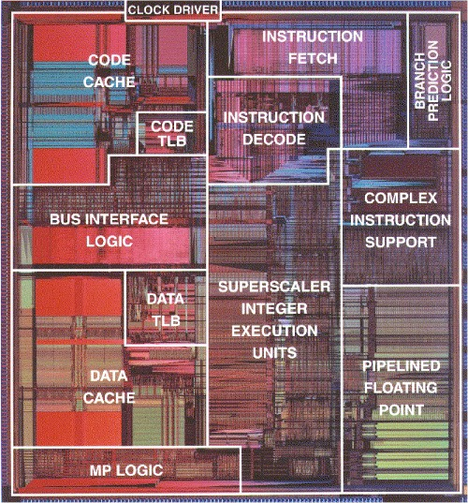
Floor Plan of Pentium Processor
1993 Intel Pentium

